Slide 1



and : Getting HELP

Slide 2
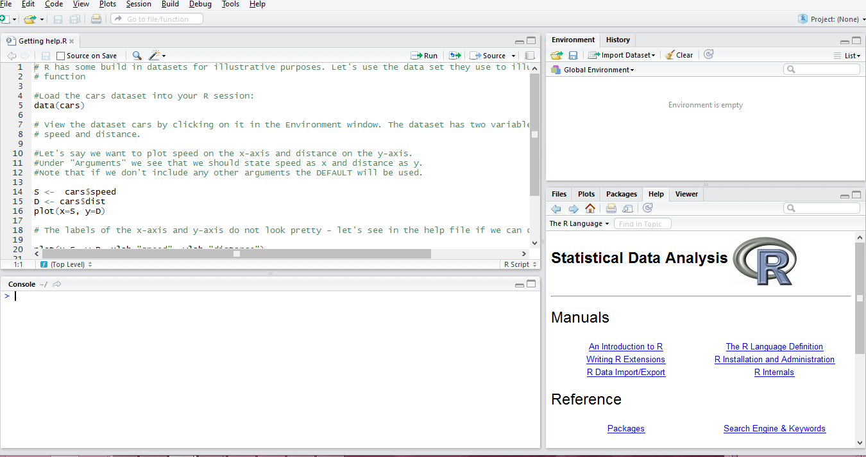
The R help files
Go to the Help window in R Studio (click on home button)

Slide 3
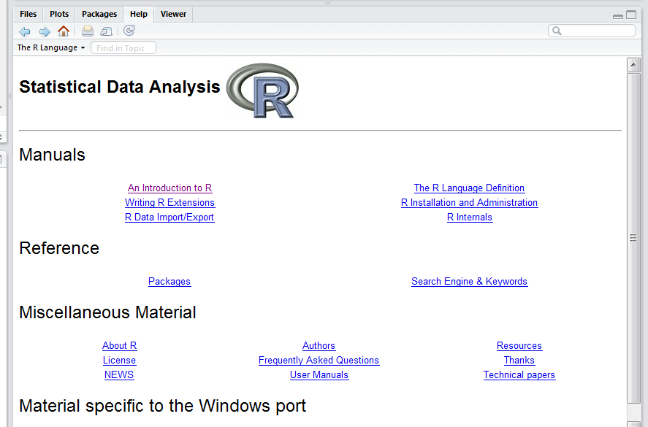

The R help files
You are presented with this problem:
Draw a random sample of 20 from a list of 100 participants
“random sample” is a key phrase to search for:

Slide 4
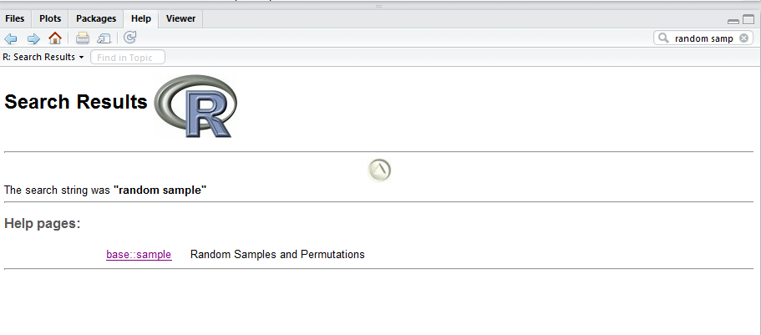
The R help files
This will return a list of all help files that contain the phrase “random sample”:

Slide 5
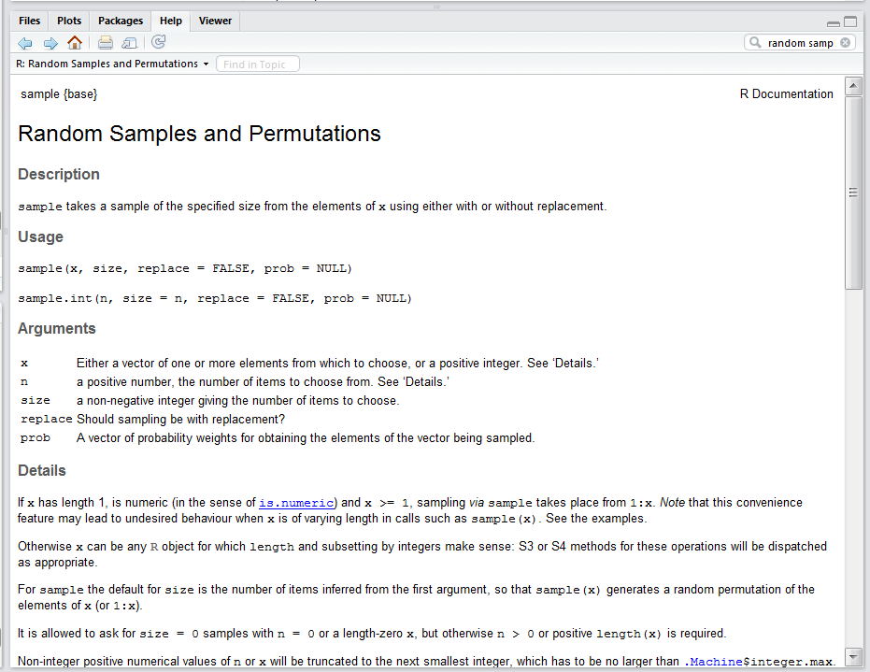
The R help files
Click on the page that looks the most appropriate:

Slide 6
The sample() function
Say you have a list of 100 participants and their unique identifiers are simply 1 to 100.
participants <- 1:100
Randomly select 20 of the 100:
sample(participants, 20)
[1] 76 57 56 50 53 28 34 20 49 22 96 70 100 73 79 92 62 38 94 54
sample(participants, 20)
[1] 23 48 75 27 32 70 60 68 100 88 29 2 38 74 93 61 81 26 15 11
sample(participants, 20)
[1] 23 14 100 10 51 37 75 30 81 15 57 17 61 45 83 25 65 41 6 36

Slide 7
The sample() function
What else can the sample() function do?
sample(participants, 20, replace = TRUE)
[1] 65 52 40 30 74 77 83 88 89 78 97 69 2 84 60 14 78 77 11 91
sample(participants, 20, replace = TRUE)
[1] 57 90 57 97 75 17 99 16 22 74 95 48 71 91 14 60 29 56 63 30
weights <- c(rep(2,50),rep(1,50))
sample(participants, 20, prob=weights)
[1] 19 73 36 75 50 44 43 59 48 39 91 11 35 41 7 92 6 12 87 52
sample(participants, 20, prob=weights)
[1] 47 87 14 33 37 59 7 93 35 40 60 44 29 77 30 18 78 48 26 41

Slide 8
Help from the console
If you have a package loaded, you can enter the following in a console to find help on that package:
?package_name
If the package is not loaded, you can enter the following in the console
??package_name
To find the documentation for a package you have installed but not loaded, enter the following:
Library(help=“package_name”)

Slide 9
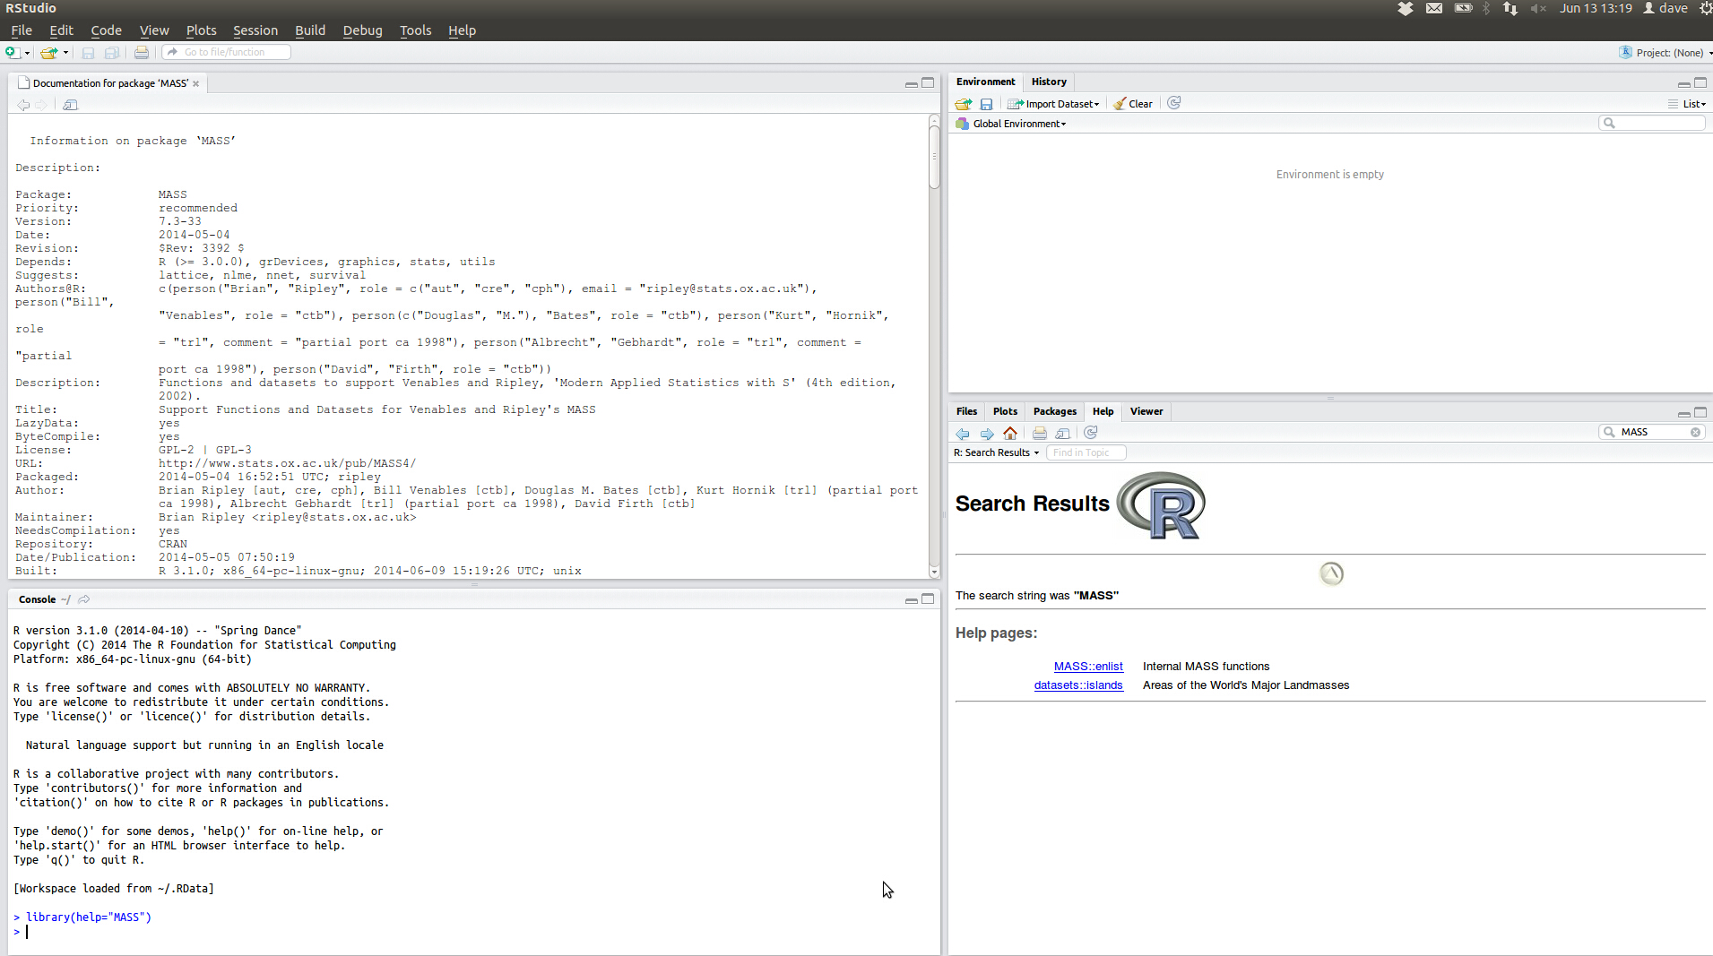
Help from the console

Slide 10
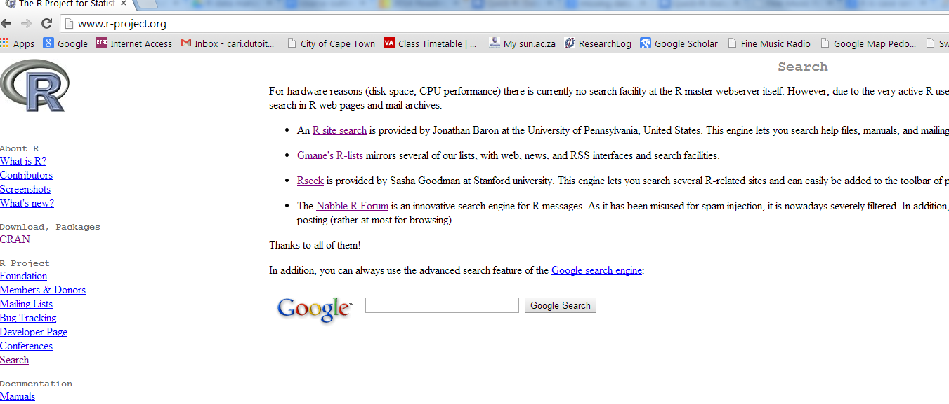
R-project.org
If you cannot find what you are looking for in the help files, go to the R website’s “Search” tab at: http://www.r-project.org/

Slide 11
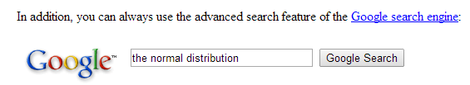
R-project.org
From here you can search in any of the four links provided, or you can perform a Google search.

Slide 12
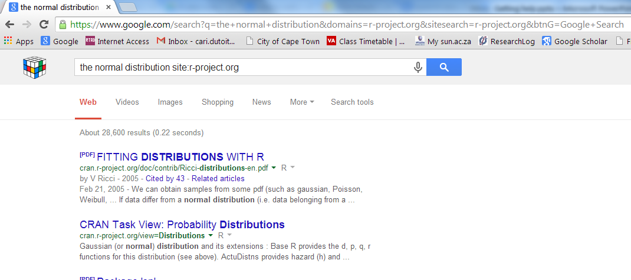
R-project.org
This will do a Google like search within the R-project website

Slide 13
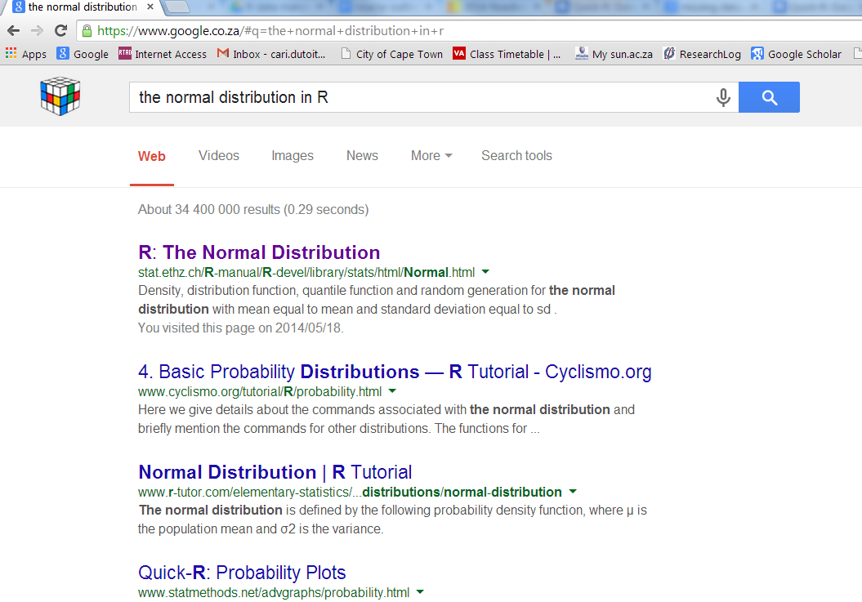
Google Search
You can also do a Google search, but be sure to add “in R” at the end of what ever you want to search.

Slide 14
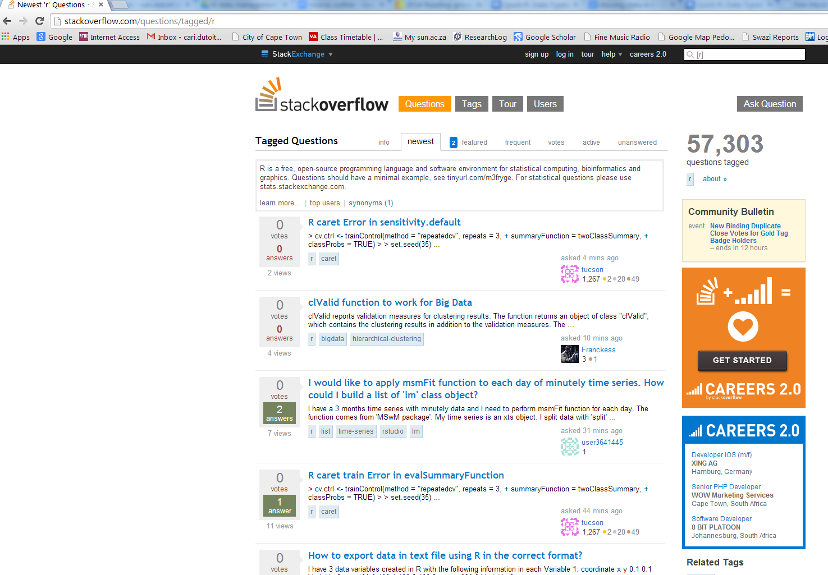
stackoverflow.com
You can search or ask a R related question in the forum www.stackoverflow.com

Slide 15
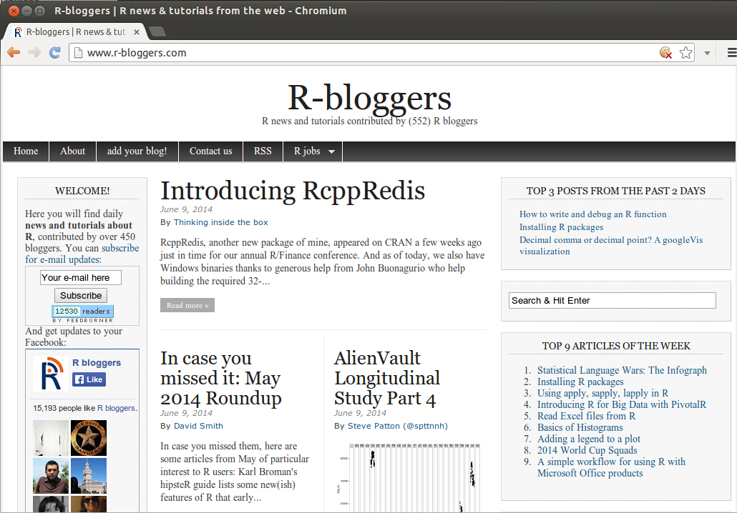
r-bloggers.com
R-Bloggers.com is a central hub (e.g: A blog aggregator) of content collected from bloggers who write about R (in English).

Slide 16
Vignettes
Some packages come with vignettes. They are essentially tutorials.
If we install the package “ape”, then load it:
library(ape)
Then enter:
vignette()
to see a list of all available vignettes on your computer.
To view a vignette for ape, enter:
vignette("MoranI", package="ape")

Slide 17
Tutorial
1) Install the following packages:
ggplot2 foreign Hmisc plyr colorspace
lubridate
ape knitr
MASS

Slide 18
Tutorial
2) Try find help for ggplot2 within RStudio.
2.1 If you need more help than is in RStudio, where else can you look?
2.2 Find more help for ggplot2 outside of RStudio.
3) From the previous session, remember how to find older versions of packages? Find previous versions of the package foreign on the CRAN website. When was the first version of foreign available on CRAN?
3.1 What is the Title in the help for foreign?
4) For Hmisc, what is the description from the help?
5) From the description in the help, what pattern does plyr make use of? And, what does this mean?
6) Besides RGB, give two other sets of colours from colorspace.
7) What does the package lubridate deal with?
8) From the help section, what does ape stand for?
9) From the help section, what is knitr an alternative to? And, how would you explain what it can be used for to someone else?
10)From the help section, give two datasets, and two functions from the package MASS.

Slide 19
answers
1)
2) We can find some help in RStudio by using either:
??ggplot2
or library(help="ggplot2")
Outside of Rstudio I would use Google to search for “ggplot2”. The first hit is: http://ggplot2.org/
And the documentation is available on that site (http://docs.ggplot2.org/current/)
3) Start at http://cran.r-project.org . Navigate to packages, and look for the package “foreign”. From this page, you can find archived versions. (http://cran.r-project.org/src/contrib/Archive/foreign/) The first archived versions was from 17-Dec-1999.
3.1) From: library(help="foreign") we can find the title to be:
“Read Data Stored by Minitab, S, SAS, SPSS, Stata, Systat, Weka, dBase, ...”
4) If we try ?Hmisc, we get:
No documentation for ‘Hmisc’ in specified packages and libraries: you could try ‘??Hmisc’
then we try ??Hmisc, and find a pointer to the documentation which can be accessed from: library(help="Hmisc") . From this, the Description is:
“The Hmisc package contains many functions useful for data analysis, high-level graphics, utility operations, functions for computing sample size and power, importing datasets, imputing missing values, advanced table making, variable clustering, character string manipulation, conversion of R objects to LaTeX code, and recoding variables.”

Slide 20
answers
5) plyr makes use of the split-apply-combine pattern in R.
6) HLS, HSV, LAB, LUV….
These can be found by using
library(help="colorspace")
7) Time and dates. “Lubridate provides tools that make it easier to parse and manipulate dates.“
8) Analyses of Phylogenetics and Evolution.
9) Alternative tool to Sweave. “The knitr package was designed to be a transparent engine for dynamic report generation with R”
10) Use
library(help="MASS")
There are many available to choose from. (Functions eg: addterm, anova.negbin. Datasets eg: Aids2, Animals)

